Slide 1
Architectural Styles
Software Architecture
Lecture 5

Slide 2
Object-Oriented Style
Components are objects
  Data and associated operations
Connectors are messages and method invocations
Style invariants
  Objects are responsible for their internal representation integrity
  Internal representation is hidden from other objects
Advantages
  “Infinite malleability” of object internals
  System decomposition into sets of interacting agents
Disadvantages
  Objects must know identities of servers
  Side effects in object method invocations
    Clean Code Vs MehtodsInvocation
Notes:
For example, simply using the right formula to compute the area of an enclosed shape will vary depending on if the shape is a triangle, rectangle, ellipse, or circle. In traditional computer programming this would result in long IF-THEN statements testing what sort of object the shape was and calling the appropriate code. The object-oriented way to handle this is to define a class called Shape with subclasses such as Rectangle and Ellipse (which in turn have subclasses Square and Circle) and then to simply send a message to any Shape asking it to compute its area. Each Shape object will then invoke the subclass's method with the formula appropriate for that kind of object.
Cache, buffer, stack, queue

Slide 3
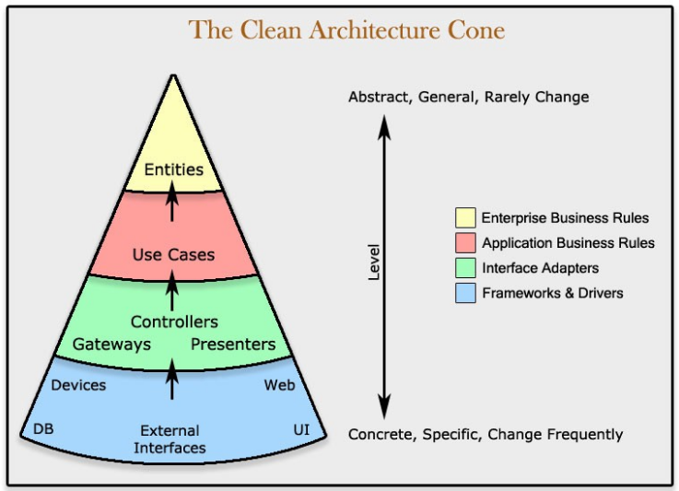
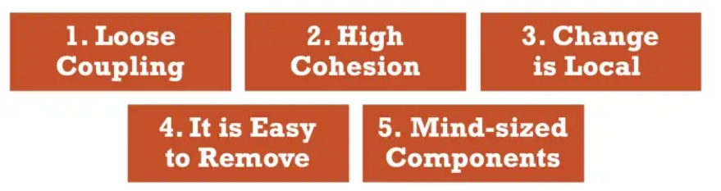
Clean Code
“The first rule of functions is that they should be small. The second rule of functions is that they should be smaller than that.” — Robert C. Martin
Notes:
1- Two machine learning components are coupled when at least one of them uses the other.
2-ML components that do change for different reasons or at different times should be kept separate.
3- Keeping ML components changes local means that there are boundaries in the design which changes do not cross.
4-When an ML block gets too complicated, it has to be removed and replaced with one or more simpler ML blocks.
5- Break your machine learning system down into Data/ML components into sizes you can grasp within your mind. The goal is to predict the consequences of changes easily (dependencies, control flow, etc,…).

Slide 4
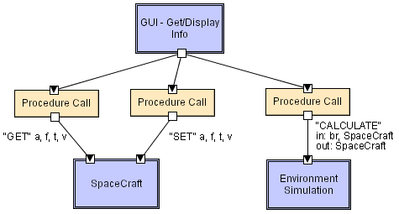
Object-Oriented LL
Software Architecture: Foundations, Theory, and Practice; Richard N. Taylor, Nenad Medvidovic, and Eric M. Dashofy; © 2008 John Wiley & Sons, Inc. Reprinted with permission.
Notes:
Spacecrat: Altitude, fuel, time, velocity Br: BurnRate , Spacecraft SpaceCraft: get, set
BurnRate: The only flight control law in this game is translation of a pilot-specified throtle percentage into a volume/second fuel-flow setting (the BurnRate) to control the des

Slide 5
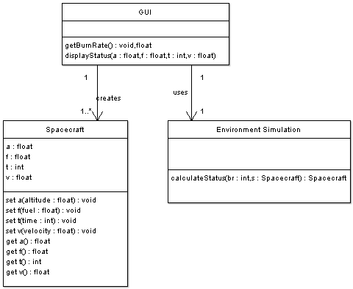
OO/LL in UML
Software Architecture: Foundations, Theory, and Practice; Richard N. Taylor, Nenad Medvidovic, and Eric M. Dashofy; © 2008 John Wiley & Sons, Inc. Reprinted with permission.

Slide 6
Layered Style
Hierarchical system organization
  “Multi-level client-server”
  Each layer exposes an interface (API) to be used by above layers
Each layer acts as a
  Server: service provider to layers “above”
  Client: service consumer of layer(s) “below”
Connectors are protocols of layer interaction
Example: operating systems
Virtual machine style results from fully opaque layers

Slide 7
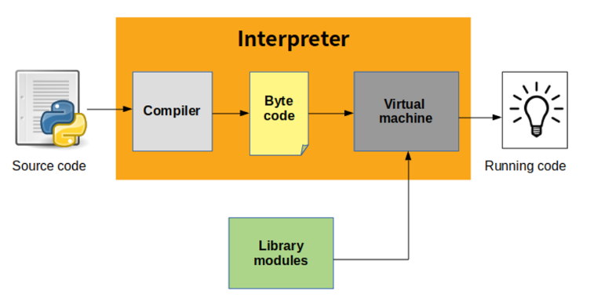
Layered Style

Slide 8
Layered Style (cont’d)
Advantages
  Increasing abstraction levels
  Evolvability
  Changes in a layer affect at most the adjacent two layers
    Reuse
  Different implementations of layer are allowed as long as interface is preserved
  Standardized layer interfaces for libraries and frameworks

Slide 9
Layered Style (cont’d)
Disadvantages
  Not universally applicable
  Performance
Layers may have to be skipped
  Determining the correct abstraction level

Slide 10
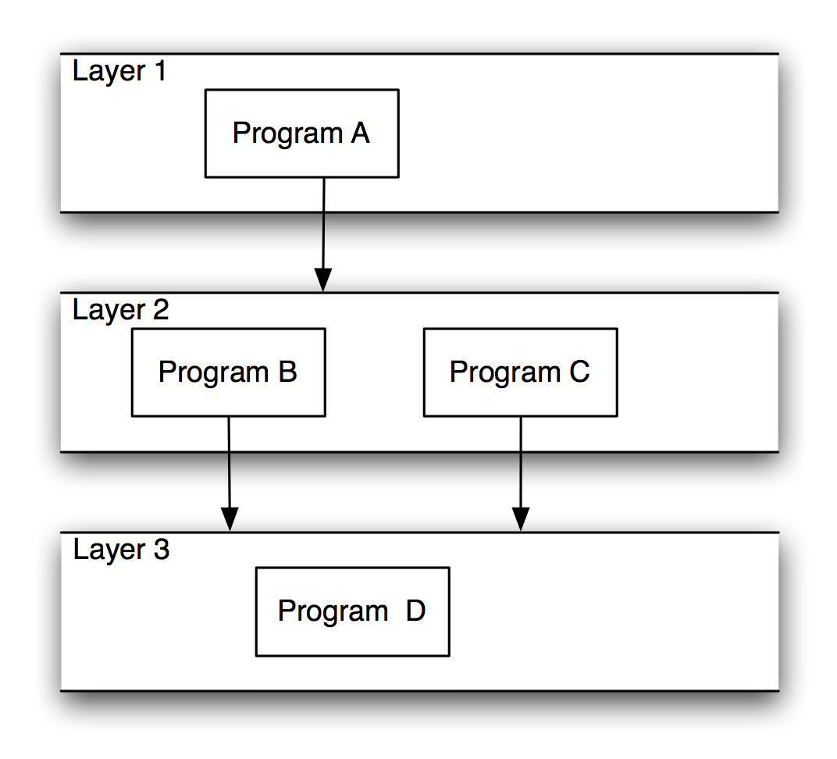
Layered Systems/Virtual Machines
Software Architecture: Foundations, Theory, and Practice; Richard N. Taylor, Nenad Medvidovic, and Eric M. Dashofy; © 2008 John Wiley & Sons, Inc. Reprinted with permission.

Slide 11
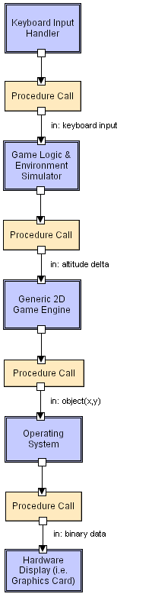
Layered LL
Software Architecture: Foundations, Theory, and Practice; Richard N. Taylor, Nenad Medvidovic, and Eric M. Dashofy; © 2008 John Wiley & Sons, Inc. Reprinted with permission.

Slide 12
Client-Server Style
Components are clients and servers
Servers do not know number or identities of clients
Clients know server’s identity
Connectors are RPC-based network interaction protocols

Slide 13
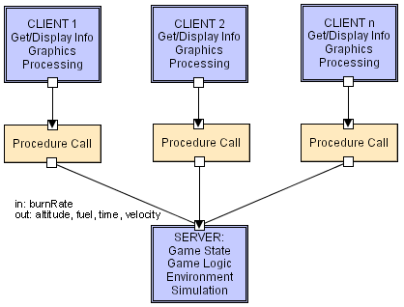
Client-Server LL
Software Architecture: Foundations, Theory, and Practice; Richard N. Taylor, Nenad Medvidovic, and Eric M. Dashofy; © 2008 John Wiley & Sons, Inc. Reprinted with permission.

Slide 14
Data-Flow Styles
Batch Sequential
  Separate programs are executed in order; data is passed as an aggregate from one program to the next.
  Connectors: “The human hand” carrying tapes between the programs, a.k.a. “sneaker-net ”
  Data Elements: Explicit, aggregate elements passed from one component to the next upon completion of the producing program’s execution.
Typical uses: Transaction processing in financial systems. “The Granddaddy of Styles”

Slide 15
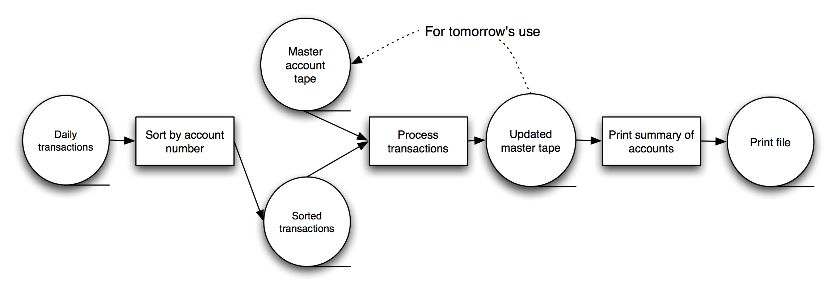
Batch-Sequential: A Financial Application
Software Architecture: Foundations, Theory, and Practice; Richard N. Taylor, Nenad Medvidovic, and Eric M. Dashofy; © 2008 John Wiley & Sons, Inc. Reprinted with permission.

Slide 16
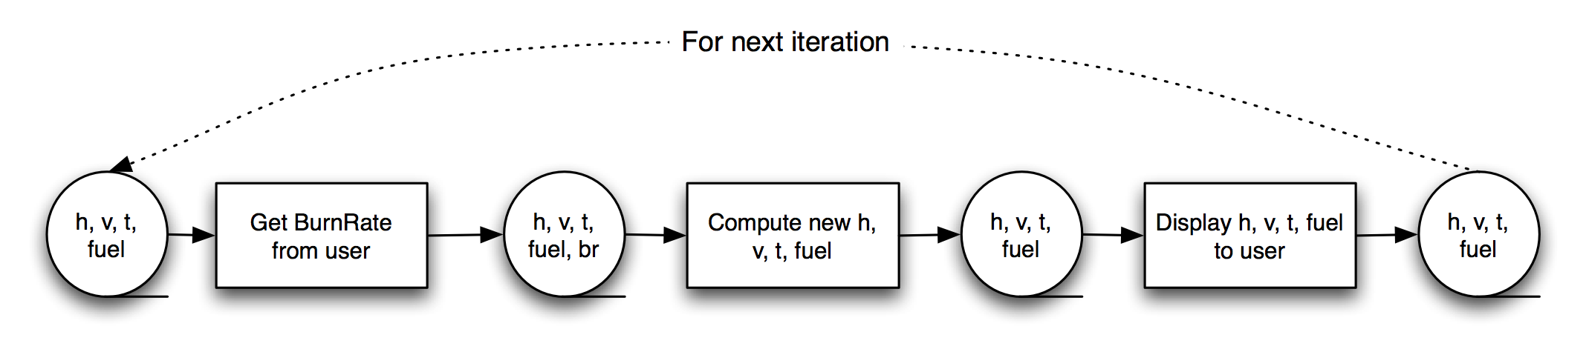
Batch-Sequential LL
Not a recipe for a successful lunar mission!
Software Architecture: Foundations, Theory, and Practice; Richard N. Taylor, Nenad Medvidovic, and Eric M. Dashofy; © 2008 John Wiley & Sons, Inc. Reprinted with permission.

Slide 17
Pipe and Filter Style
Components are filters
  Transform input data streams into output data streams
  Possibly incremental production of output
Connectors are pipes
  Ducts for data streams
Style invariants
  Filters are independent (no shared state)
  Filter has no knowledge of up- or down-stream filters
Examples
  Distributed systems parallel programming

Slide 18
Pipe and Filter (cont’d)
Variations
  Pipelines — linear sequences of filters
  Bounded pipes — limited amount of data on a pipe
  Typed pipes — data strongly typed
Advantages
  System behavior is a succession of component behaviors
  Filter addition, replacement, and reuse
    Possible to hook any two filters together
  Certain analyses
    Throughput, latency, deadlock
    Concurrent execution
Notes:
The time it takes for a packet to travel from the source to its destination is referred to as latency. Latency indicates how long it takes for packets to reach their destination. Throughput is the term given to the number of packets that are processed within a specific period of time.
The throughput of a CPU pipeline is the # of instructions completed per second.
Throughput - Number of processes completed per unit time. May range from 10 / second to 1 / hour depending on the specific processes. Turnaround time - Time required for a particular process to complete, from submission time to completion.

Slide 19
Pipe and Filter (cont’d)
Disadvantages
  Batch organization of processing
  Interactive applications
  Lowest common denominator on data transmission

Slide 20

Pipe and Filter LL
Software Architecture: Foundations, Theory, and Practice; Richard N. Taylor, Nenad Medvidovic, and Eric M. Dashofy; © 2008 John Wiley & Sons, Inc. Reprinted with permission.
Notes:
GetBurnRate runs continuously on its own, prompting the user for a new burn rate.
In this design the “compute new values” determines how much time has passed. Could alternatively do that in the GetBurnRate filter. Would change semantics a bit.

Slide 21
Blackboard Style
Two kinds of components
  Central data structure — blackboard
  Components operating on the blackboard
System control is entirely driven by the blackboard state
Examples
  Typically used for AI systems

Slide 22
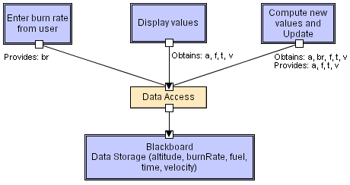
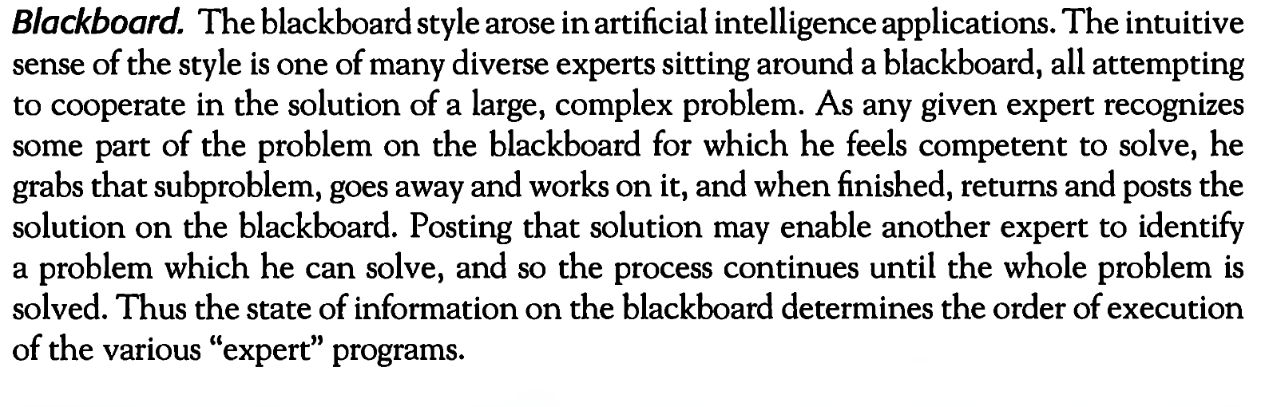
Software Architecture: Foundations, Theory, and Practice; Richard N. Taylor, Nenad Medvidovic, and Eric M. Dashofy; © 2008 John Wiley & Sons, Inc. Reprinted with permission.

Slide 23
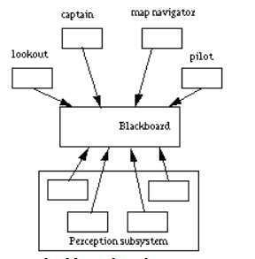
Blackboard Style
The "captain", the overall supervisor.
The "map navigator", the high level path planner.
The "lookout", a module that monitors the environment for landmarks.
The "pilot", the low level path planner and motor controller.
Mobile Robot

Slide 24
Rule-Based Style
Inference engine parses user input and determines whether it is a fact/rule or a query. If it is a fact/rule, it adds this entry to the knowledge base. Otherwise, it queries the knowledge base for applicable rules and attempts to resolve the query.
Notes:
Definition. In the shared-memory architecture, the entire memory, i.e., main memory and disks, is shared by all processors. A special, fast interconnection network (e.g., a high-speed bus) allows any processor to access any part of the memory in parallel.

Slide 25

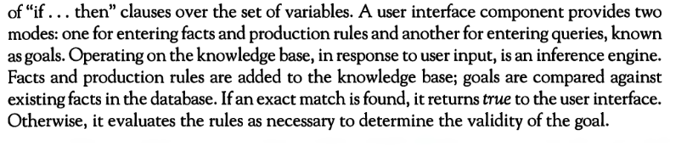
Rule-Based Style

Slide 26
Rule-Based Style (cont’d)
Components: User interface, inference engine, knowledge base
Connectors: Components are tightly interconnected, with direct procedure calls and/or shared memory.
Data Elements: Facts/rules and queries
Behavior of the application can be very easily modified through addition or deletion of rules from the knowledge base. E.g., Car price prediction
Caution: When a large number of rules are involved understanding the interactions between multiple rules affected by the same facts can become very difficult.
  This is where ML and DL comes into business.

Slide 27
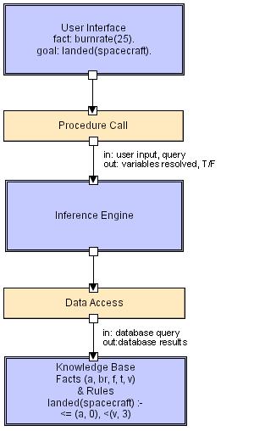
Rule Based LL
Goal = Query
Software Architecture: Foundations, Theory, and Practice; Richard N. Taylor, Nenad Medvidovic, and Eric M. Dashofy; © 2008 John Wiley & Sons, Inc. Reprinted with permission.

Slide 28
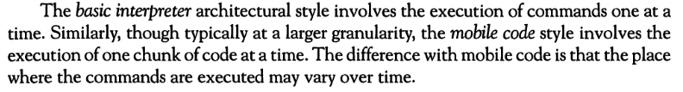
Interpreter
  Basic Interpreter
  Mobile Code
  Dynamic Behavior

Slide 29
Interpreter Style
Interpreter parses and executes input commands, updating the state maintained by the interpreter
Components: Command interpreter, program/interpreter state, user interface.
Connectors: Typically very closely bound with direct procedure calls and shared state.
Highly dynamic behavior possible, where the set of commands is dynamically modified. System architecture may remain constant while new capabilities are created based upon existing primitives.
Superb for end-user programmability; supports dynamically changing set of capabilities
Notes:
NLTK contains a module called tokenize() which further classifies into two sub-categories: Word tokenize: We use the word_tokenize() method to split a sentence into tokens or words. Sentence tokenize: We use the sent_tokenize() method to split a document or paragraph into sentences.
A parser is a compiler or interpreter component that breaks data into smaller elements for easy translation into another language. A parser takes input in the form of a sequence of tokens, interactive commands, or program instructions and breaks them up into parts that can be used by other components in programming.
Definition. In the shared-memory architecture, the entire memory, i.e., main memory and disks, is shared by all processors. A special, fast interconnection network (e.g., a high-speed bus) allows any processor to access any part of the memory in parallel.

Slide 30
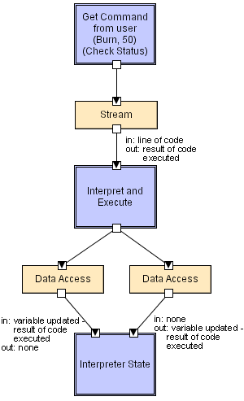
Interpreter LL
=IF(Something is True, then do something, otherwise do something else)
=IF(B2>97,"A+",IF(B2>93,"A",IF(B2>89,"A-",IF(B2>87,"B+",IF(B2>83,"B",IF(B2>79,"B-", IF(B2>77,"C+",IF(B2>73,"C",IF(B2>69,"C-",IF(B2>57,"D+",IF(B2>53,"D",IF(B2>49,"D-","F"))))))))))))
Software Architecture: Foundations, Theory, and Practice; Richard N. Taylor, Nenad Medvidovic, and Eric M. Dashofy; © 2008 John Wiley & Sons, Inc. Reprinted with permission.

Slide 31
Mobile-Code Style
Summary: a data element (some representation of a program) is dynamically transformed into a data processing component.
Components: “Execution dock”, which handles receipt of code and state; code compiler/interpreter
Connectors: Network protocols and elements for packaging code and data for transmission.
Data Elements: Representations of code as data; program state; data
Variants: Code-on-demand, remote evaluation, and mobile agent.

Slide 32
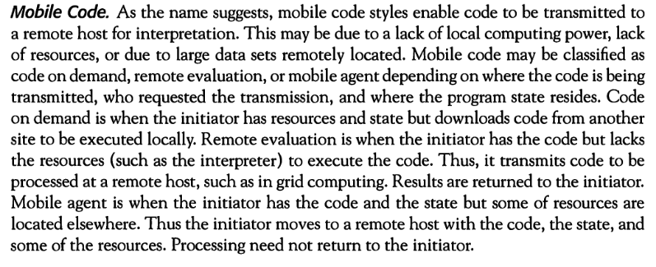

Slide 33
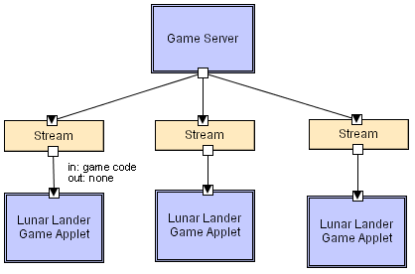
Mobile Code LL
Java applet.
Software Architecture: Foundations, Theory, and Practice; Richard N. Taylor, Nenad Medvidovic, and Eric M. Dashofy; © 2008 John Wiley & Sons, Inc. Reprinted with permission.

Slide 34
Implicit Invocation Style
Event announcement instead of method invocation
  “Listeners” register interest in and associate methods with events
  System invokes all registered methods implicitly
Component interfaces are methods and events
Two types of connectors
  Invocation is either explicit or implicit in response to events
Style invariants
  “Announcers” are unaware of their events’ effects
  No assumption about processing in response to events

Slide 35
Implicit Invocation (cont’d)
Advantages
  Component reuse
Disadvantages
  No knowledge of what components will respond to event
  No knowledge of order of responses

Slide 36
Publish-Subscribe
Subscribers register/deregister to receive specific messages or specific content. Publishers broadcast messages to subscribers either synchronously or asynchronously.

Slide 37
Publish-Subscribe (cont’d)
Components: Publishers, subscribers, proxies for managing distribution
Connectors: Typically a network protocol is required. Content-based subscription requires sophisticated connectors.
Data Elements: Subscriptions, notifications, published information
Topology: Subscribers connect to publishers either directly or may receive notifications via a network protocol from intermediaries
Qualities yielded Highly efficient one-way dissemination of information with very low-coupling of components
Notes:
Client subscribes only ones but receive notification lifetime like in facebook friends. While in implicit invocation, we have to register every time we want information about the event like in webinars.

Slide 38
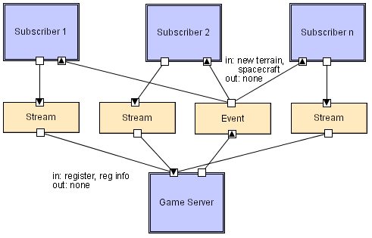
Pub-Sub LL
Software Architecture: Foundations, Theory, and Practice; Richard N. Taylor, Nenad Medvidovic, and Eric M. Dashofy; © 2008 John Wiley & Sons, Inc. Reprinted with permission.

Slide 39
Event-Based Style
Independent components asynchronously emit and receive events communicated over event buses
Components: Independent, concurrent event generators and/or consumers
Connectors: Event buses (at least one)
Data Elements: Events – data sent over the event bus
Topology: Components communicate with the event buses.
Variants: Component communication with the event bus may either be push or pull based.
Highly scalable, easy to evolve, effective for highly distributed applications.
Notes:
Any recipient may query the connector to see if new event is available
Pull : would like to fetch the information, blocking (query process will keep on waiting until a response about new event is received), non-blocking (outcome of the query will be received irrespective of new even available or not)
Push: recipient would want the information to be disseminated.
First class entity: Cannot be changed

Slide 40
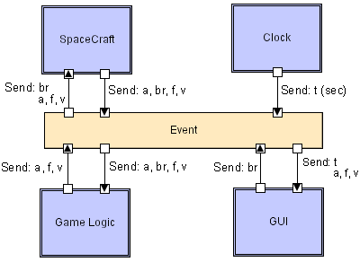
Event-based LL
Software Architecture: Foundations, Theory, and Practice; Richard N. Taylor, Nenad Medvidovic, and Eric M. Dashofy; © 2008 John Wiley & Sons, Inc. Reprinted with permission.

Slide 41
Peer-to-Peer Style
State and behavior are distributed among peers which can act as either clients or servers.
Peers: independent components, having their own state and control thread.
Connectors: Network protocols, often custom.
Data Elements: Network messages

Slide 42
Peer-to-Peer Style (cont’d)
Topology: Network (may have redundant connections between peers); can vary arbitrarily and dynamically
Supports decentralized computing with flow of control and resources distributed among peers. Highly robust in the face of failure of any given node. Scalable in terms of access to resources and computing power. But caution on the protocol!
Notes:
Network redundancy is a process through which additional or alternate instances of network devices, equipment and communication mediums are installed within network infrastructure. It is a method for ensuring network availability in case of a network device or path failure and unavailability.

Slide 43
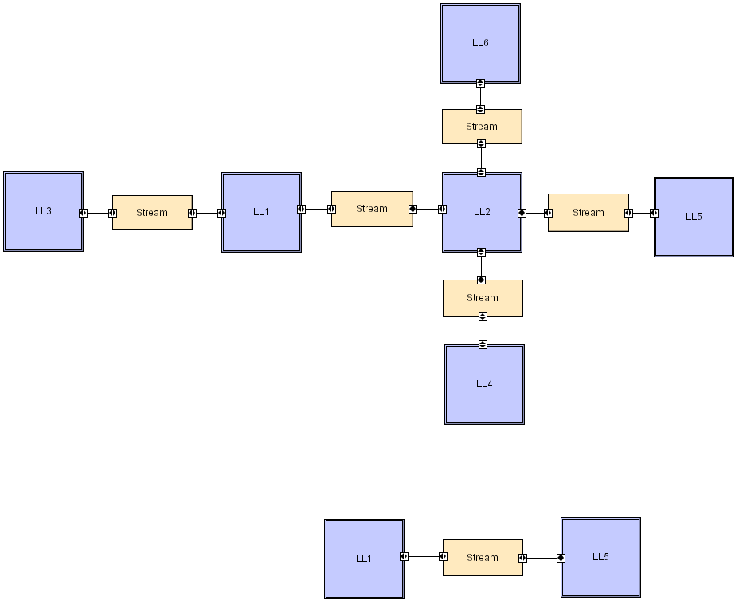
Peer-to-Peer LL
Software Architecture: Foundations, Theory, and Practice; Richard N. Taylor, Nenad Medvidovic, and Eric M. Dashofy; © 2008 John Wiley & Sons, Inc. Reprinted with permission.

